Slide 1


Customer Shopping Behavior Analysis
Uncovering insights from 3,900 purchases to guide strategic business decisions

Slide 2




Dataset Overview
3,900
18
37
Total Purchases
Data Columns
Missing Values
Comprehensive transaction data analyzed to uncover core buying patterns.
In-depth customer demographics and detailed shopping behavior metrics.
High data integrity; missing values found only within the Review Rating column.

Slide 3
Data Preparation Process
STEP 04
Feature Engineering
STEP 02
Initial Exploration
Created age groups and categorized purchase frequency.
Conducted structure checks and summary statistics.
STEP 01
STEP 03
STEP 05
Data Loading
Missing Data
Database Integration
Imported the raw dataset securely using pandas structures.
Imputed missing values within Review Rating using medians.
Connected to PostgreSQL for robust downstream analysis.

Slide 4
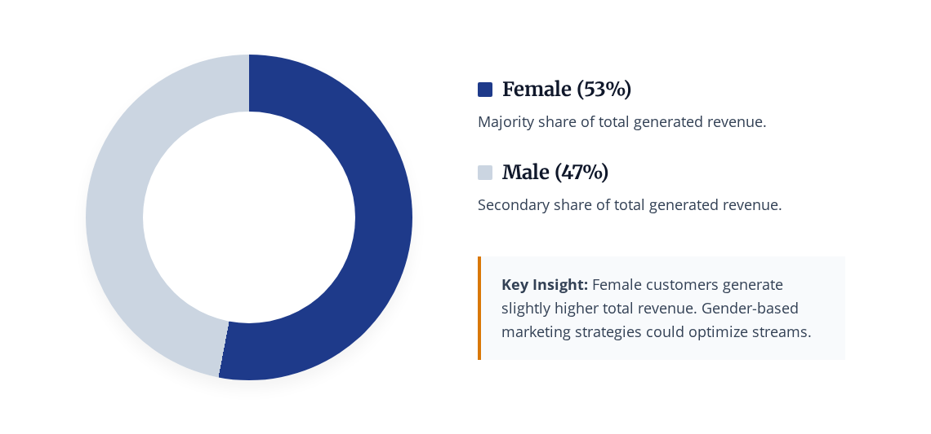
Revenue by Gender Analysis

Slide 5

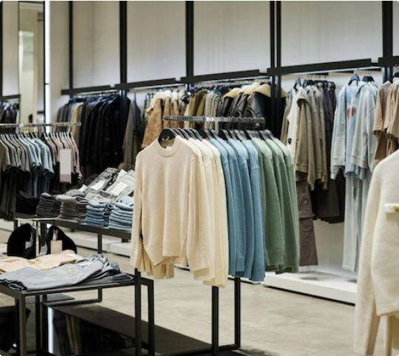
Discount Usage Optimization
High-Value Discount Users
Customers using discounts while maintaining a spending average above the baseline.
Smart Shoppers
High spenders who actively maximize value by utilizing available discount codes.
Strategic Opportunity
Target premium customers with exclusive, tier-based offers to drive further volume.

Slide 6




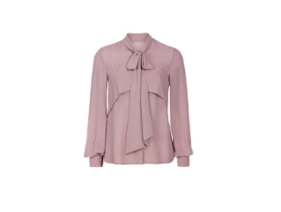

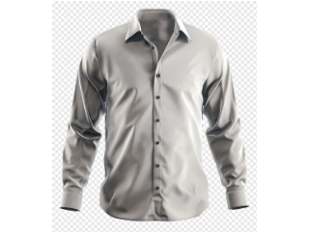
Top-Rated Products Category
5 Star: Blouse
5 Star: Dress
4 Star: Shirt
Highest customer satisfaction ratings across all apparel categories.
Consistently excellent reviews detailing fit, material, and design.
Strong customer approval and solid performance in daily wear.

Slide 7
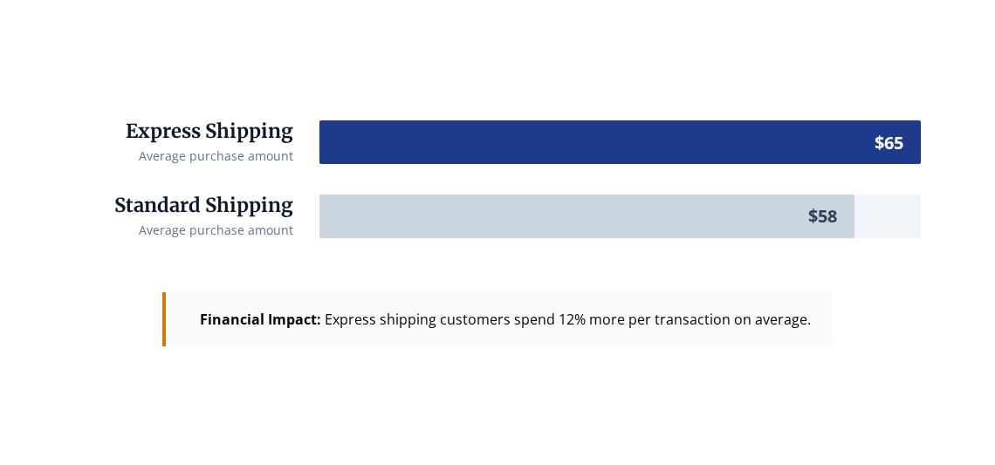
Shipping Preferences Impact

Slide 8

Subscription Impact & Loyalty
68%
78%
Higher Spend
Revenue Share
Loyalty Rate
Subscribers compared to non-subscribers
Generated strictly from subscription customers
Consistently high repeat purchase frequency

Slide 9
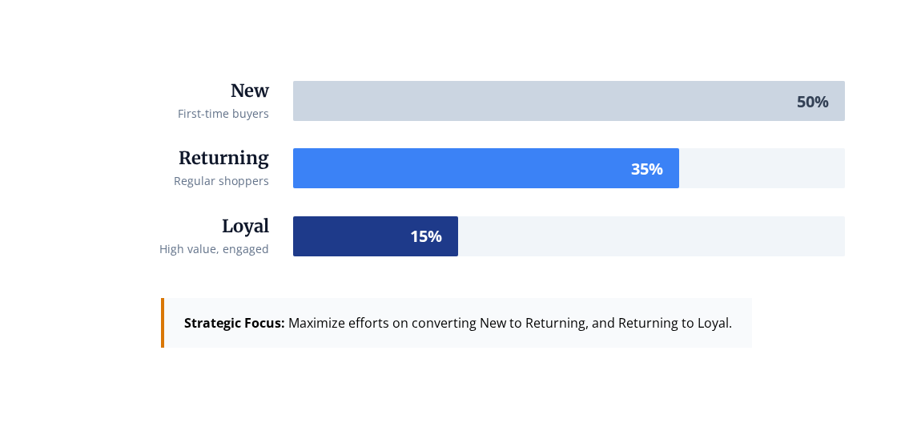
Customer Segmentation Profile

Slide 10








Strategic Recommendations
Boost Subscriptions
Loyalty Programs
Promote exclusive, high-value benefits specifically designed for active subscribers.
Reward repeat buyers systematically to increase long-term customer retention.
Targeted Marketing
Product Positioning
Focus marketing spend heavily on high-revenue segments and express shipping users.
Highlight top-rated products prominently in all major acquisition campaigns.

Slide 11





Image Sources
https://img.freepik.com/premium-photo/wide-shot-modern-fashion-shop-interior_249974-19178.jpg
Source: www.magnific.com
https://media.istockphoto.com/id/1218433118/photo/womens-light-blouse-isolated-on-white-background.jpg?s=612x612&w=0&k=20&c=sxhAMhOHwcyKrXXaI1vQMr4y00PypbOMABROW2YwmAE=
Source: www.istockphoto.com
https://img.magnific.com/free-photo/portrait-beautiful-caucasian-smiling-brunette-woman-model-bright-pink-blue-summer-stylish-clothes-isolated-white-background_158538-2899.jpg?semt=ais_hybrid&w=740&q=80
Source: www.magnific.com
https://banner2.cleanpng.com/20240413/eqb/transparent-formal-shirt-grey-shirt-long-sleeve-button-up-coll-grey-buttonless-long-sleeve-shirt-modern-style661af838ceafd1.70489298.webp
Source: www.cleanpng.com
https://plus.unsplash.com/premium_photo-1764691235091-ded85505e95b?fm=jpg&q=60&w=3000&auto=format&fit=crop&ixlib=rb-4.1.0&ixid=M3wxMjA3fDB8MHxwaG90by1wYWdlfHx8fGVufDB8fHx8fA%3D%3D
Source: unsplash.com

